Slide 1
DES - Experiment
Group 11
Tenna Cortz, Henrik Frank & Mads Riisom

Slide 2
Agenda
Goal
Experiment
Data
Visualization
Threats to validity
Conclusion

Slide 3
Goal
Investigate the performance difference between Test Driven Development (TDD) and the more common Code First Test After (CFTA) approach.

Slide 4
Experiment
Test subjects
Questionnaires
Coding Tasks
Sliced Test Last,
Sliced Test First
Non-Sliced Test Last
Non-Sliced Test First

Slide 5
Data
Pre questionnaire
Post questionnaire
Code

Slide 6
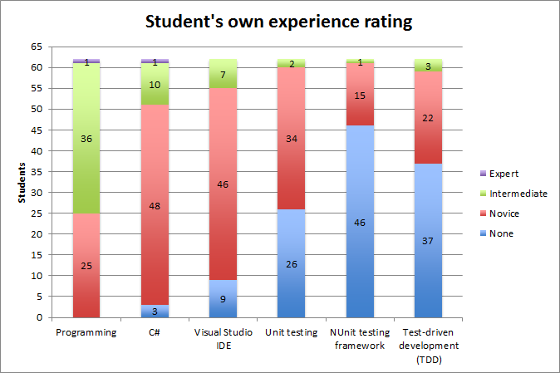

Slide 7
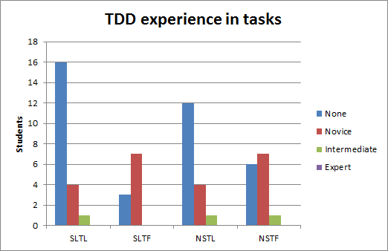

Slide 8
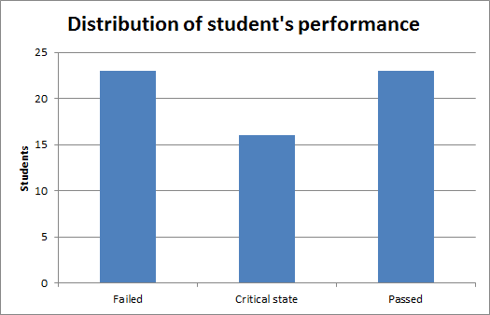

Slide 9
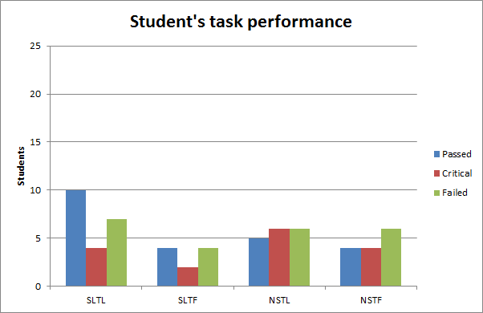
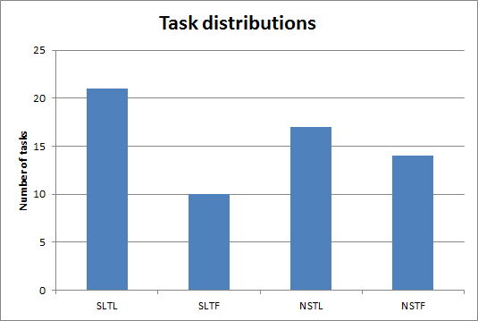

Slide 10
Threads to validity
Internal Threats
External Threats
Social Threats
Conclusion Threats

Slide 11
No definitive conclusion

Slide 12
Questions?

